Slide 1



Implementing Chess Game
PROJECT MEMBERS
1.Boomadevi S [23ITR016]
2.Gowri D [23ITR048]
3.Arunprasad S [23ITR008]
JAIHARI D (19ITR028)
PROJECT GUIDE
Dr.Devisurya Asst.Prof

Slide 2

Challenge: Developing a functional and interactive chess game
Complexity: Requires implementing chess rules, move validation, and game state management.
User Requirements: Must support piece movements, game statistics, and user interaction.
Data Management: Need to store and manage chess pieces and board state efficiently.
Persistence: Save and load game states to support resuming games.

Slide 3
Objectives
Design: Create a comprehensive chess game with complete functionality.
Data Structures: Use arrays, linked lists, or other structures to manage the chessboard and pieces.
Algorithms: Implement sorting and search algorithms for efficient piece management.
Validation: Ensure move validation adheres to chess rules.
User Interface: Develop a command-line interface (CLI) for game interaction and display.
3

Slide 4
Software / Hardware Tools used
Programming Language: Java
IDE/Editor: Visual Studio
Version Control: Git for version management and collaboration.
Libraries: Standard libraries for data structures and file handling.
Operating System: Cross-platform support (Windows).
4

Slide 5
Implementation Details
Define an abstract Piece class and concrete classes for each piece
data structures to represent the chessboard, pieces, and moves
A chessboard can be represented using a 2D array
Define an abstract Piece class and concrete classes for each piece
Create a class to handle the GUI using AWT
LinkedList can be used to keep track of each move made during the game.
Use a linked list to store and manage the move history.
2D ARRAY
LINKED LIST
STACK
AWT
Chess Board
5

Slide 6
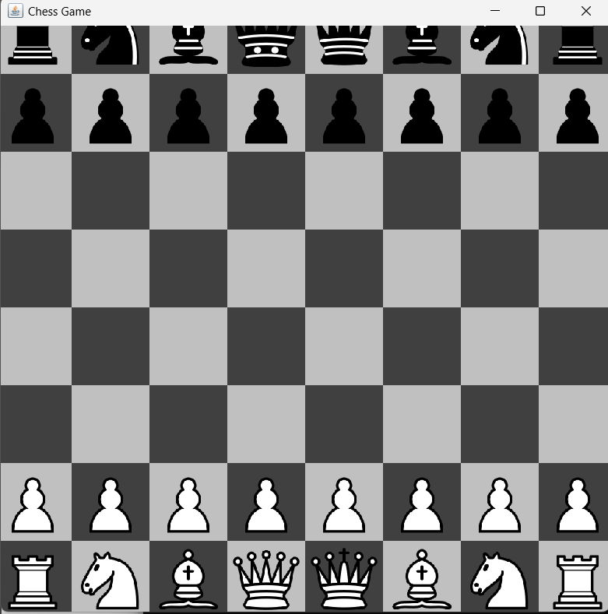

Slide 7
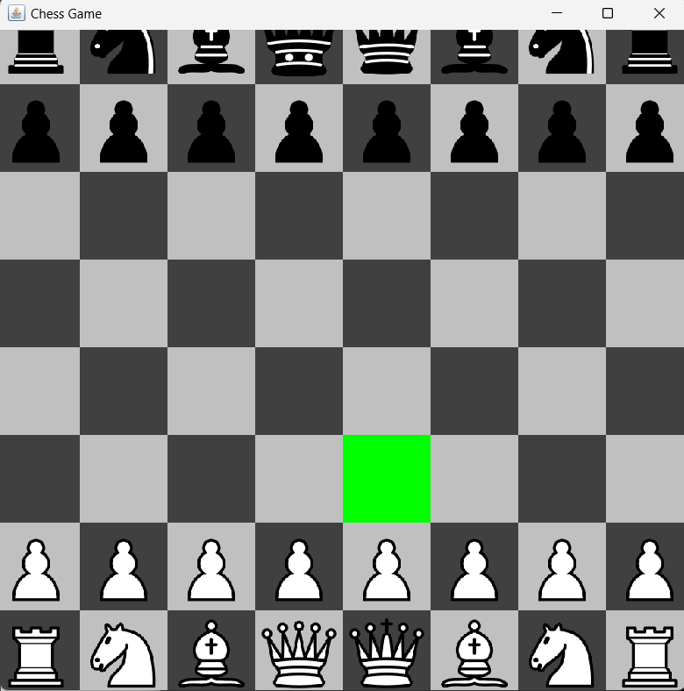
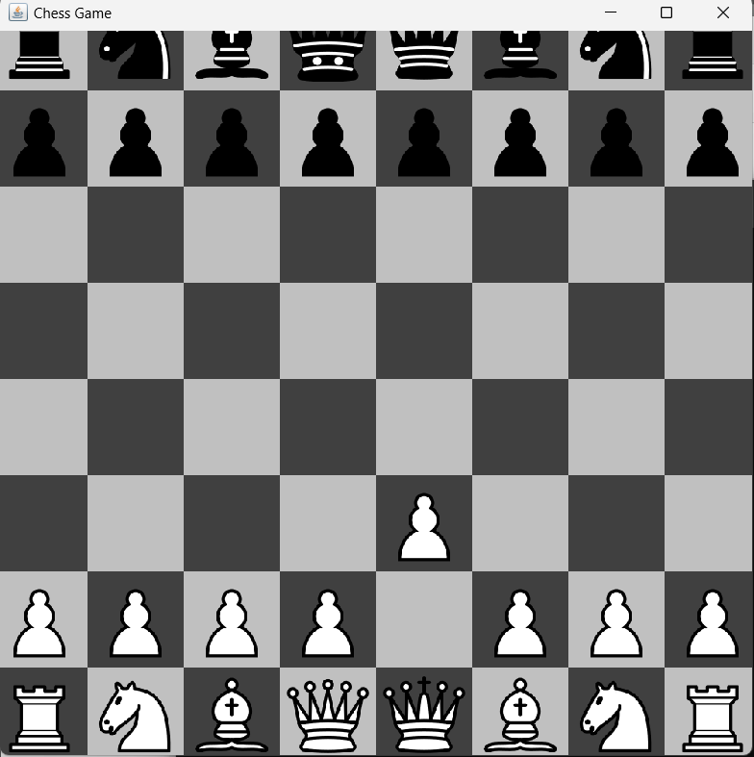

Slide 8
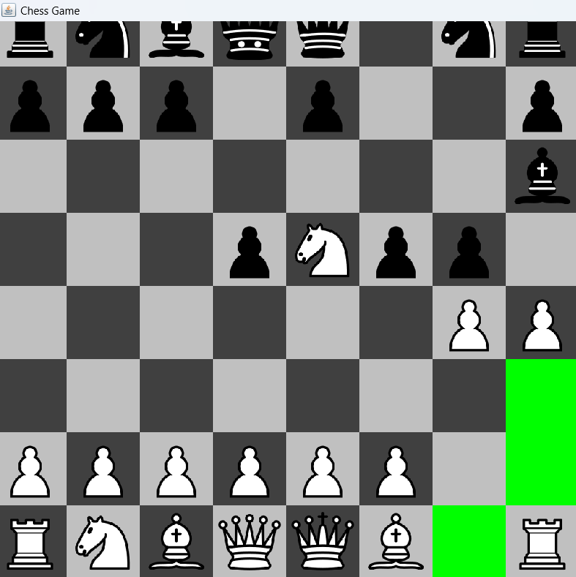
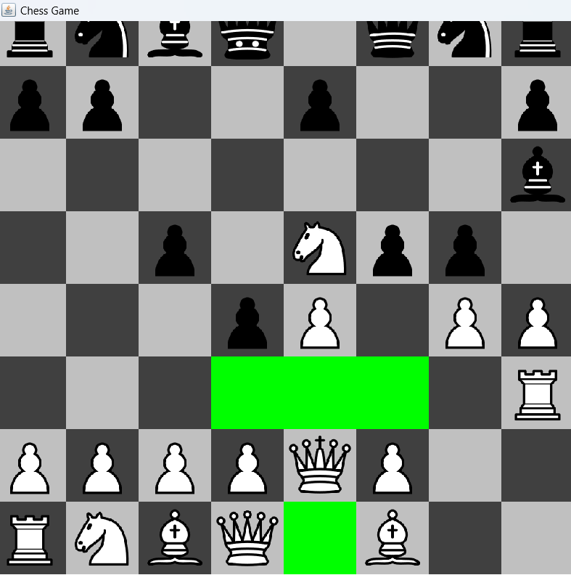

Slide 9
Thank you!

